Slide 1
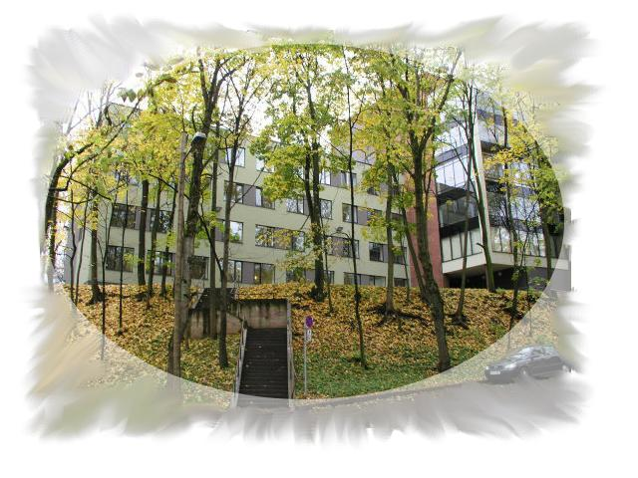
IM in Estonia
Liivi tn.2 50409 Tartu

Slide 2
Dissemination
- Article in the Newsletter of Estonian Mathematical Society (in Estonian)
- EU-MORNET Workshop and MC Meeting in Tartu, 8 - 9 February 2018 (https://sisu.ut.ee/eu_mornet)
Topics included into some courses
Seminar “How to move towards Industry 4.0” in SPARK DEMO (http://sparkdemo.ee/)
-Estonian Center for Industrial Mathematics Ξ Initiated actively
(https://www.facebook.com/ksii11/)

Slide 3
Mathematics for Industry Network Service
Problem
Implementation
Innovatsion
Success
Efficiency
Replaced by Mathematical Model
Numerical experiments and Simulations
Provisional results (gratis?)
Interpretation of results
Industrial Mathematics
Yes -
OK
Is it good enough?
No – something changed

Slide 4
Main plan for the future:
First Estonian Study Group With Industry, 4 – 8 February 2019

