Slide 1
Planning of sales territories and delivery routes
(Infora Research Group)
ESGI SI: European Study Group
Mathematics With Industry Workshop 2017
Bled, Slovenia

Slide 2
Team Members
Coordinator: Infora Research Group, Nebojša Gvozdenović
Members: Timotej Hrga
Jelena Klisara
Borut Lužar
Tea Vizinger
Tomaž Kokolj
Mentors: Janez Povh
Janez Žerovnik

Slide 3
Problem Description
Optimization problem:
Minimize the cost of delivering goods from depots to stores.
Simplified constraints:
Goods are classified into brands and each store has a list of brands it is selling
            Every salesman is presenting one brand only
            Each store must be visited every week, first by a salesman and then by a delivery vehicle:
            Salesmen check supplies and send information to depots.
            Based on this information vehicles have to deliver the goods in the next 24 hours.

Slide 4
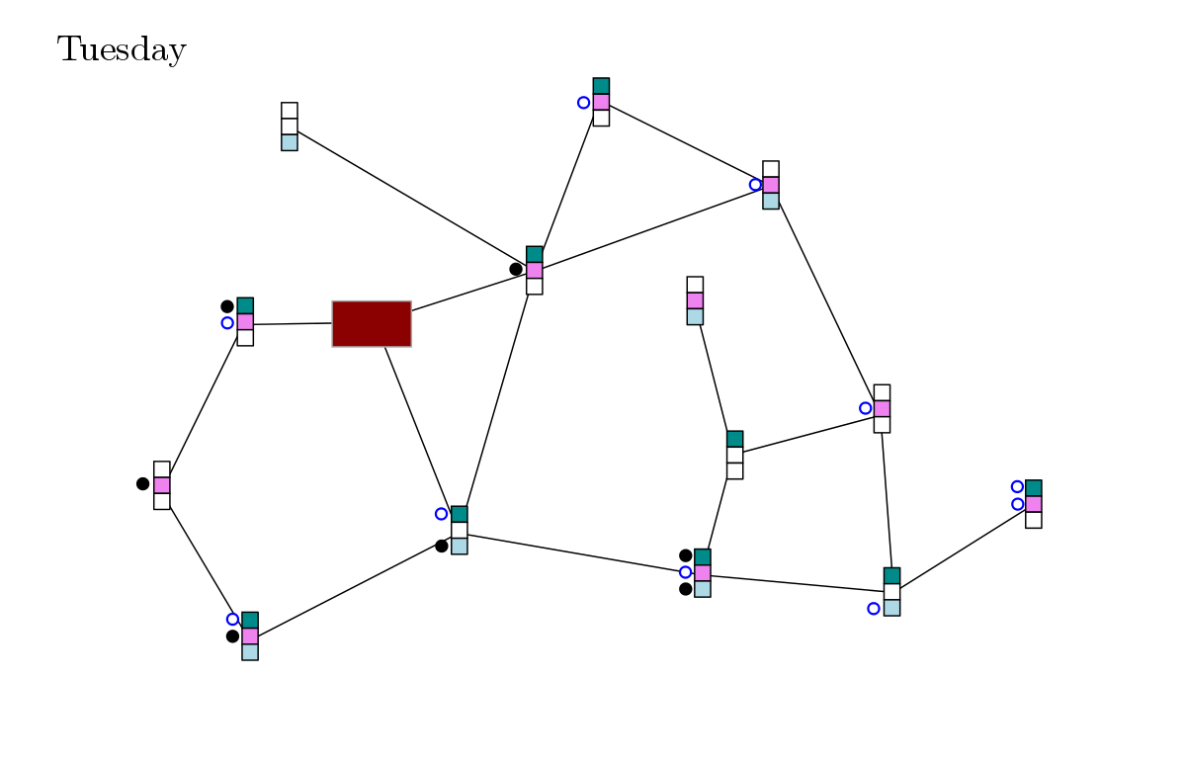
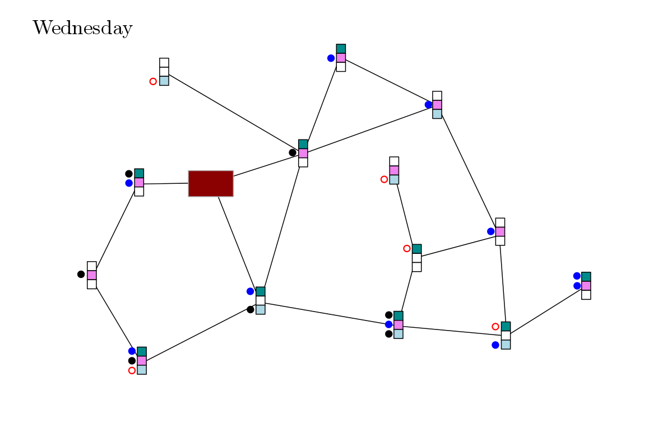
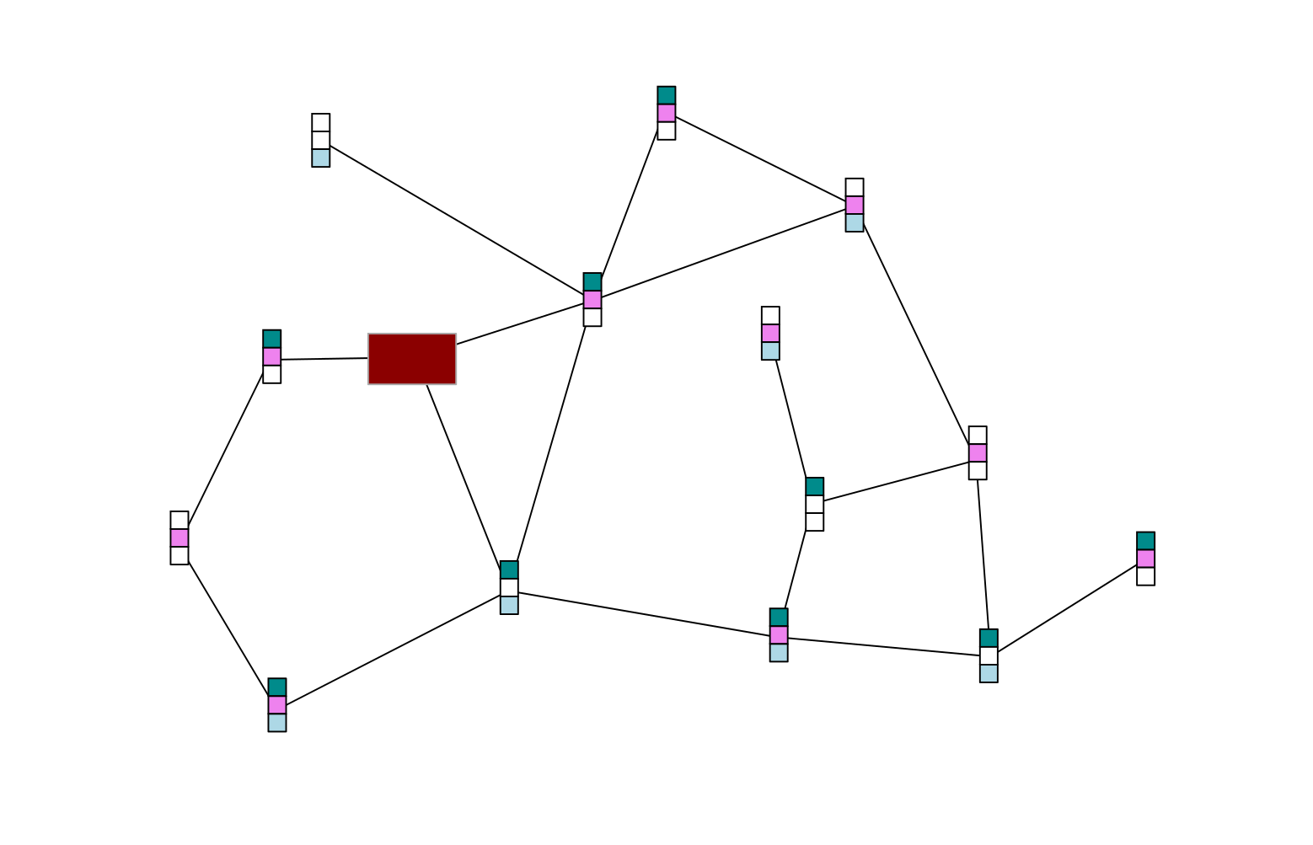
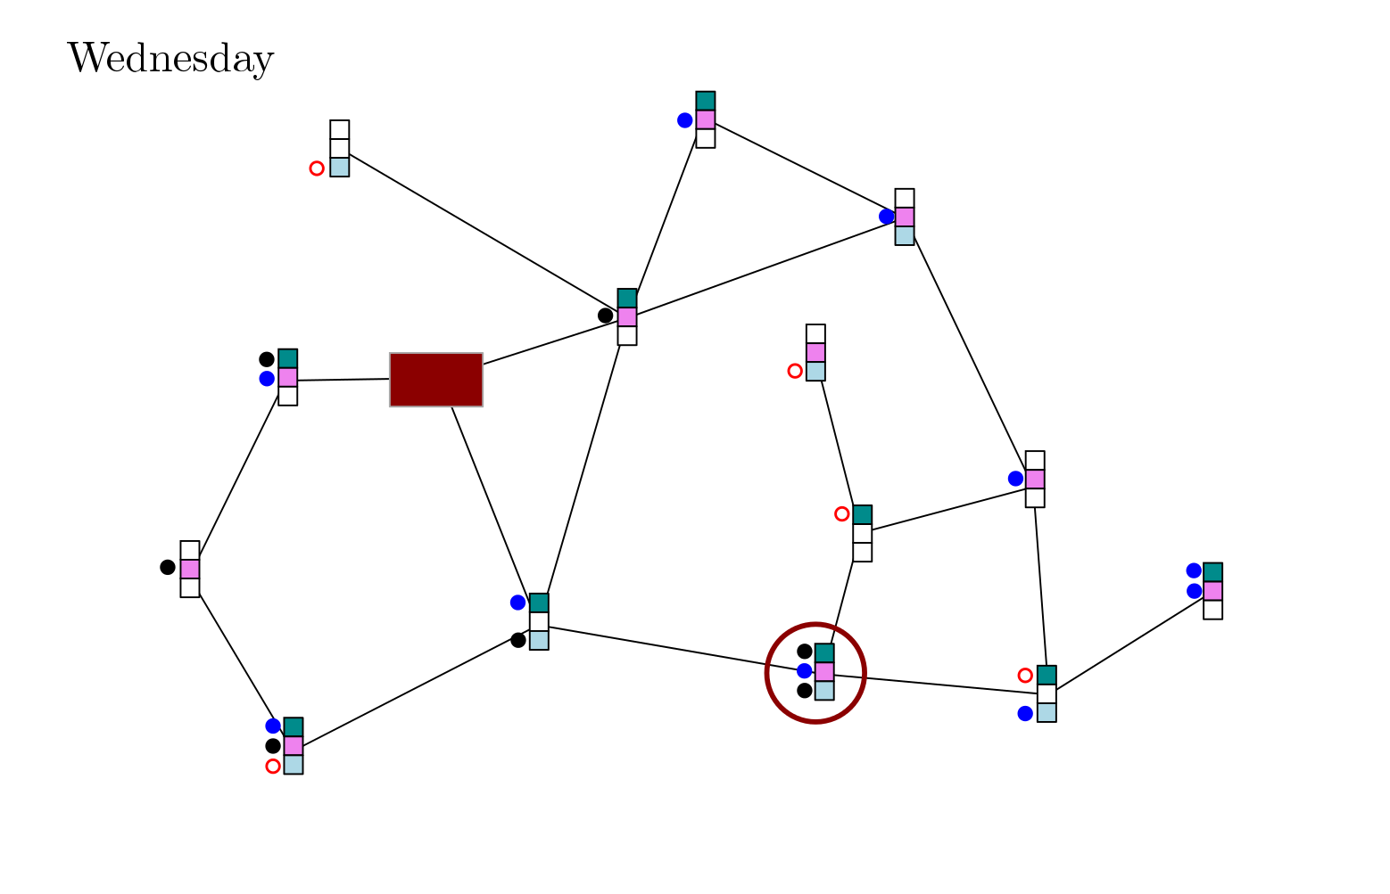
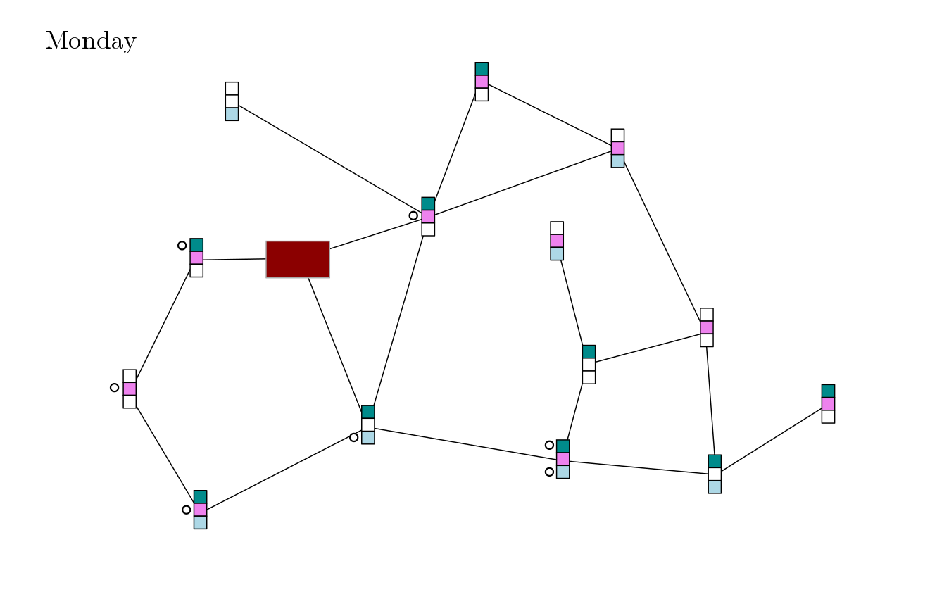

Slide 5
Problem Goal
Many algorithms exist for solving Traveling Salesman and Vehicle Routing problems separately.
Main idea:
for every store schedule the visits of salesmen for all brands within one day.
Consequently, we will be able to send only one delivery vehicle to each store.
As the delivery costs are higher than the costs of salesmen visits, the total cost is reduced.

Slide 6
Problem Data
List of depots with their locations
List of brands
List of delivery vehicles with their capacities and price per km
List of shops:
- list of needed brands (quantity, visiting time, delivering time)
- list of locations
- supplying depot

Slide 7
Solving Procedure 1
Construct a network of stores and depots (edges weighted by distances/times).
Partition network into clusters of stores such that for each cluster a delivery vehicle can provide supplies within 8 hours.
Clusters represent vertices of a new „visiting network“. We color the vertices of this network with 5 colors in the most balanced way.

Slide 8
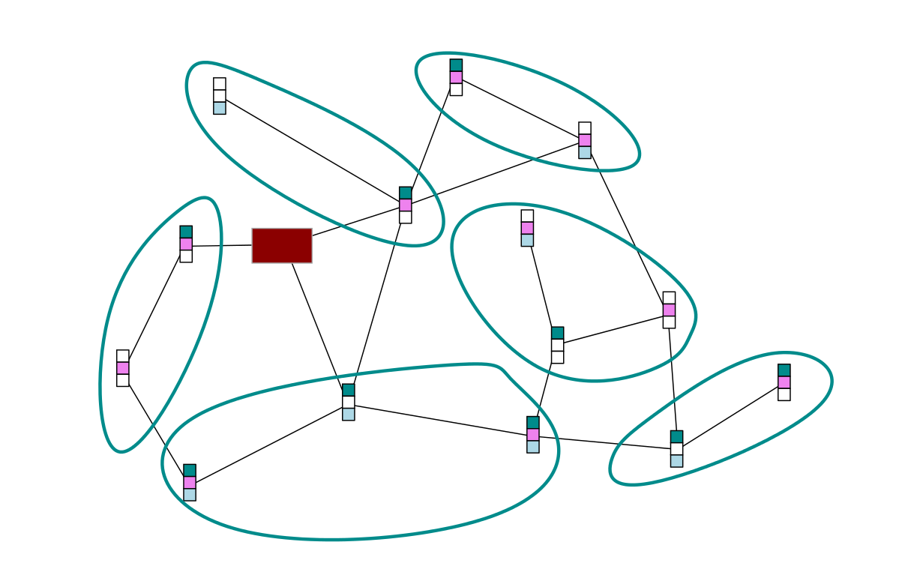
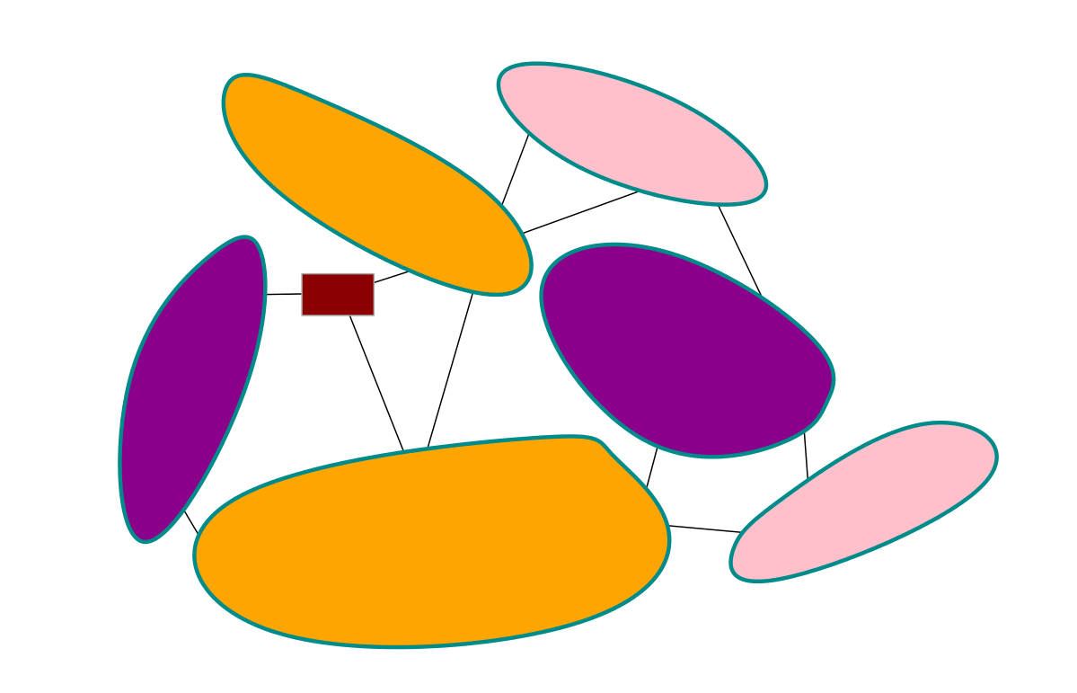
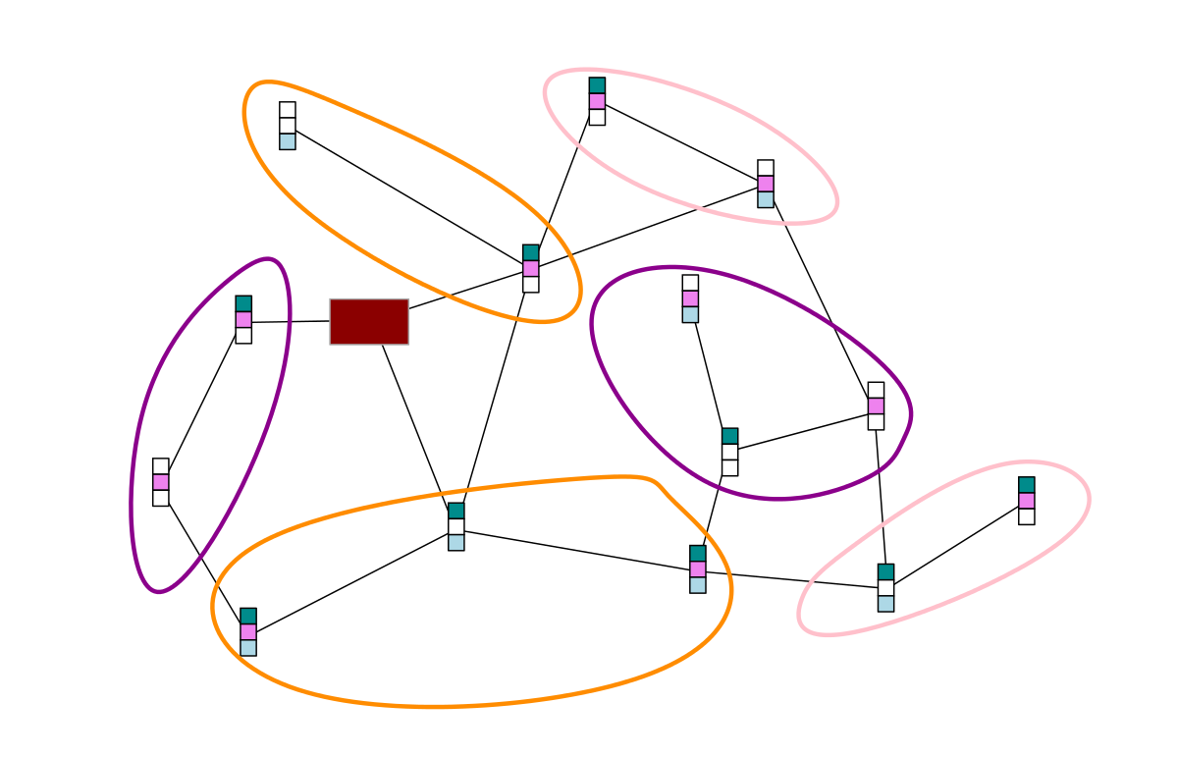

Slide 9
Solving Procedure 2
All the stores in the clusters of the same color must be visited by salesmen within the same day (to ensure only one visit of a delivery vehicle in the same week).
For every brand we create a subnetwork, the vertices of which must be visited by the salesmen of this brand.
To each salesman we assign a route constrained by the distances between stores and their visiting times.
Based on the supply demands given by salesmen, recompute the clusters from step 2.

Slide 10
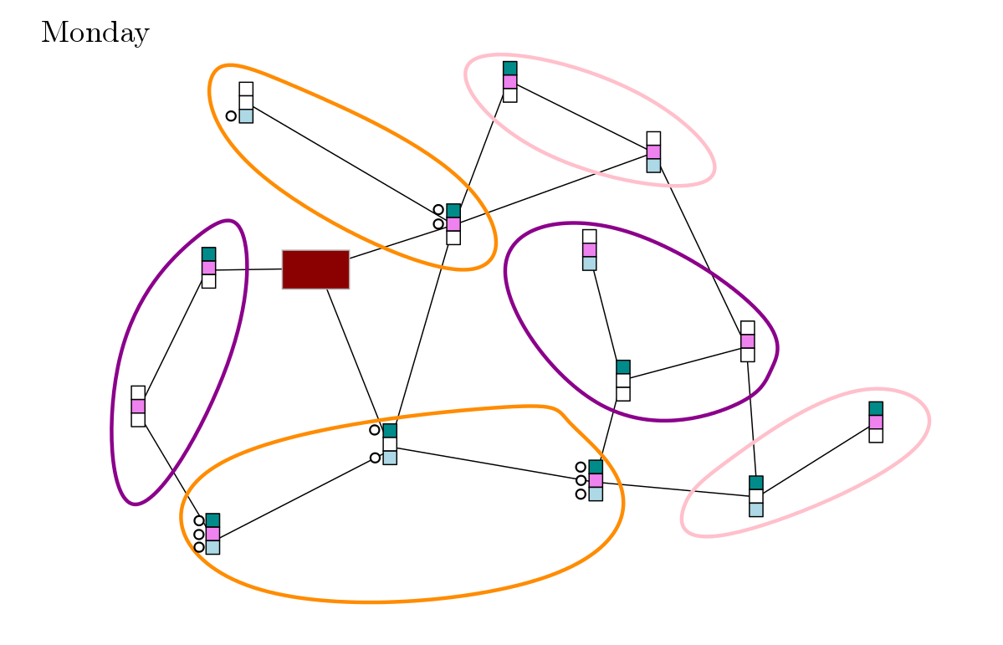
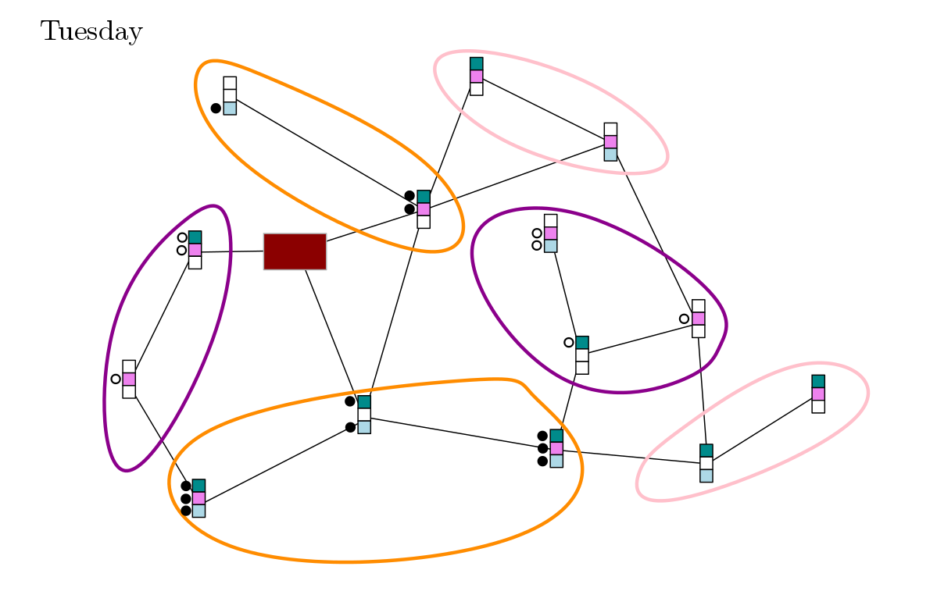
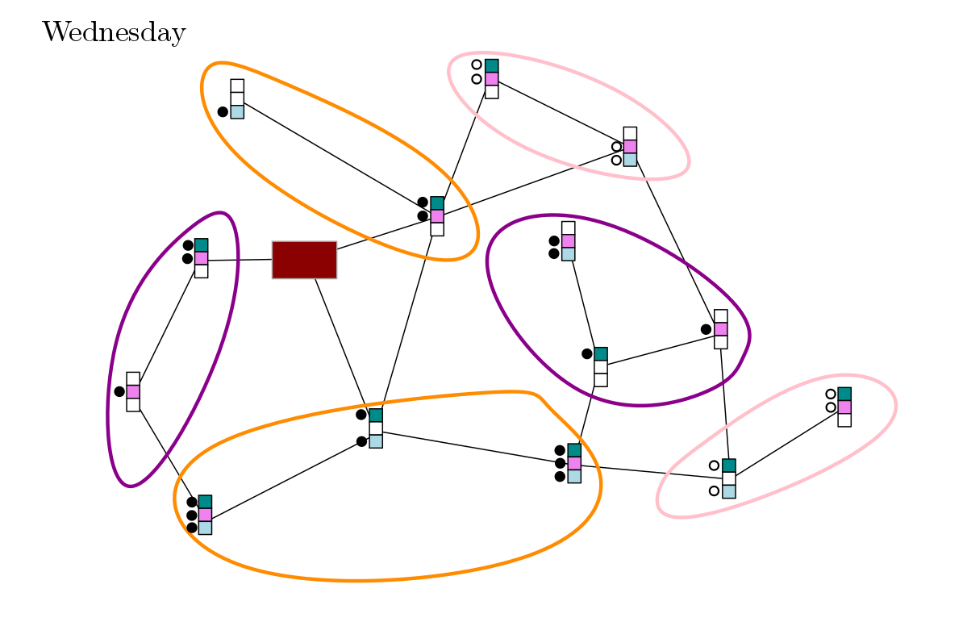


Slide 11
Procedure Output
Visiting routes for salesmen with estimated costs
Distribution routes for delivery vehicles with estimated costs

Slide 12
THANK YOU!

